Slide 1
上周
从FaaS的角度讲故事
聚焦两类Data analytics应用：Map-Reduce sort应用和数据库查询应用
思考论文中的设计如何实现、测试如何复现？
分布式cache^{[1]}、增加快速存储^{[2]}、混合数据传输方式^{[3]}、共享日志^{[4]}
如何去跑这两类应用？
open source
[1] Cloudburst: Stateful Functions-as-a-Service VLDB’20
[2] Shuffling, Fast and Slow: Scalable Analytics on Serverless Infrastructure NSDI’19
[3] Sonic: Application-aware Data Passing for Chained Serverless Applications ATC’21
[4] Boki: Stateful Serverless Computing with Shared Logs SOSP’21

Slide 2
Serverless Data Analytics
李涛
2021.12.31
Notes:
- 关键词
-- serverless
-- data analytics
- 逻辑：背景、动机、挑战都是按照这两个关键词讲述的

Slide 3
Background
Serverless = FaaS + BaaS ^{[1]}
Disaggregation of storage and compute
Serverless
sandbox
API Gateway
object storage
request
stateless
function
data、state....
KV database
.....
FaaS
BaaS
Serverless computing model
[1] Cloud Programming Simplified: A Berkeley View on Serverless Computing
Notes:
- serverless 采用的是存储计算分离的方式，由FaaS提供计算资源，BaaS提供存储服务
- 下面是一个serverless的计算模型：当请求到达时，首先通过API网关路由到对应的沙箱，然后在沙箱中实例化无状态函数进行计算，函数所产生的的状态或者销毁，或 者存储到后端的数据库中

Slide 4
Background
Traditional serverless application
eg：web microservices and IoT applications
Characteristics：per request consists of a single function
Serverless data analytics
eg：MapReduce Sort、Query processing...
Characteristics
per request consist of multiple stages
require sharing of state and data across stages of tasks
Notes:
- 传统的serverless应用
-- 有网络微服务，比如社交网络；和物联网应用，比如网上商店。
-- 特征：这类应用比较简单，大部分请求只会调用一个函数
- serverless 数据分析应用
-- 比如说mapreduce模式的大规模排序、视频分析（编码、图像识别）、数据库查询处理
-- 特征：每个请求包含多个阶段，不同阶段的任务需要分享状态和数据

Slide 5
Motivation
Serverless
High elasticity
Fine-grain billing
Short startup time
Data analytics
Low resource utilization
Within a stage：BSP
Across stages：TPC-DS query 95：0.8Mb ~ 66Gb
Interactive requirement
Interactive queries
High resource utilization & Low cost & Low latency
Notes:
- serverless
-- 高弹性，伸缩扩展能力强
-- 细粒度的收费：按需收费，根据存储计算资源的使用情况进行收费，同时以毫秒为力度进行收费，传统架构按照小时或者分钟收费
-- 启动时间短，通常使用容器作为函数实例化的沙箱，相较于虚拟机来说，启动时间短
- data analytics
-- 资源利用率低
-- 有些任务有时延上的要求，比如说交互式的查询任务

Slide 6
Challenges
Serverless function communication
Local storage
no long-running application framework
agent to manage local storage
limited local storage
Direct communication
no control over task scheduling or placement
execute time limitation
Remote slow storage
S3(object storage)
DynamoDB(KV database)
AWS lambdas 3GB RAM 512MB disk
Notes:
- serverless函数通信主要有两种方案：本地存储或者直接通信
-- 本地存储，比如Spark Hadoop都是通过这种方式传输中间数据
--- 一方面没有持久运行的客户端管理这些本地的存储资源
--- 每个函数分配的存储资源十分有限
-- 直接通信
--- 无法控制任务的调度和放置，无法保证接收方和发送方同步执行
--- 执行时间有限，数据传输可能无法全部完成

Slide 7
Challenges
Data analytics characteristics
Large scale shuffle
Serverless function communication
Remote slow storage
High latency

Slide 8
Solution
Cloudburst^{[1]}
Locus^{[2]}
SONIC^{[3]}
Boki^{[4]}
[1] Cloudburst: Stateful Functions-as-a-Service VLDB’20
[2] Shuffling, Fast and Slow: Scalable Analytics on Serverless Infrastructure NSDI’19
[3] Sonic: Application-aware Data Passing for Chained Serverless Applications ATC’21
[4] Boki: Stateful Serverless Computing with Shared Logs SOSP’21
Notes:
- serverless 采用的是存储计算分离的方式，由FaaS提供计算资源，BaaS提供存储服务
- 下面是一个serverless的计算模型：当请求到达时，首先通过API网关路由到对应的沙箱，然后在沙箱中实例化无状态函数进行计算，函数所产生的的状态或者销毁，或 者存储到后端的数据库中

Slide 9
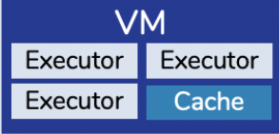
Cloudburst^{[1]}
Design
LDPC
Logical Disaggregation with Physical Colocation
Provision, scale, and bill storage and compute independently
Co-locate compute and data in close physical proximity
Implementation
Autoscaling key-value store State sharing
Mutable caches co-located with function executors Data locality
AutoScaling Key-Vaule Store（Anna）
[1] Cloudburst: Stateful Functions-as-a-Service VLDB’20
Notes:
- LDPC
-- 逻辑上分离，物理上集中; 独立的分配、扩展、支付存储和计算资源；但是在物理上将存储和计算放在一起，提供数据局部性
- 实现
-- 通过一个自动扩展的kv存储系统实现 数据共享；通过为每个函数分配虚拟机上的缓存资源提供数据局部性

Slide 10
Cloudburst^{[1]}
Design
Consistency
Colocation of compute and data
Distributed cache
Function composition
Run across multiple nodes
Distributed session consistency
[1] Cloudburst: Stateful Functions-as-a-Service VLDB’20

Slide 11
Cloudburst^{[1]}
Design
Consistency
Consensus protocols
Implement strong consistency across caches √
Don’t fit the dynamic autoscaling framework ×
Coordination-free consistency
Repeatable read consistency
Causal consistency
[1] Cloudburst: Stateful Functions-as-a-Service VLDB’20
Notes:
- 传统的共识协议可以实现较强的一致性，但是不是可动态自动扩展的框架
- 因此需要无协调的的一致性
-- 实现了可重复读一致性
-- 因果一致性

Slide 12


Cloudburst^{[1]}
Architecture
Distributed cache
Cache inconsistencies
Cloudburst Runtime
AutoScaling Key-Vaule Store （Anna）
An overview of the Cloudburst architecture
[1] Cloudburst: Stateful Functions-as-a-Service VLDB’20
Notes:
- 利用分布式缓存来提供一定的数据局部性，以此来降低通信的时延
- 但是分布式缓存会带来缓存一致性的问题

Slide 13
Locus^{[2]}
Design
Combines slow storage with fast storage
Slow storage
eg：Amazon S3, Google Cloud Storage, Azure Blob Store
Characteristics: scalable and elastic object storage；
low throughput on reading and writing small files(request rate llimit
&optimized for large chunks of data);
high cost for large shuffle($0.005/1,000 requests)
Fast storage
eg：ElastiCache, Memorystore, Azure Cache
Characteristics: high request rates( 100,000 requests/sec per shard)
efficiently handle small objects (tens of byte)
expensive storage cost(1GB/h 0.00319 cents S3；2.344 cents Elasti
-Cache）
Performance&cost trade-off
[2] Shuffling, Fast and Slow: Scalable Analytics on Serverless Infrastructure NSDI’19
Notes:
- Slow storage
-- However, these storage systems are not designed to support high throughput on reading and writing small files; scalable and elastic blob storage; In fact, all major public cloud providers impose a global transaction limit on shared object stores; the majority of large scale storage systems have
been optimized for reading and writing large chunks of data,rather than for high-throughput fine-grained operations
-- 存储费用包含两部分：一部分是存储数据；一部分是读取请求；对于slow storage存储成本很低，而且中间数据得生命周期很短，因此存储成本可以忽略不计
- Fast storage
-- 对于快速存储只收取存储费用

Slide 14
Locus^{[2]}
Design
Combines slow storage with fast storage
Slow storage based shuffle
Degree of parallelism
Worker memory size
Performance&cost trade-off
large amount small objects
Throughpt
Bandwith
Limited
[2] Shuffling, Fast and Slow: Scalable Analytics on Serverless Infrastructure NSDI’19
Notes:
- 将快慢存储进行组合，首先将任务进行分组，每一组内的中间数据由快存储保存，最后将分组的数据合并，以此提高性能

Slide 15
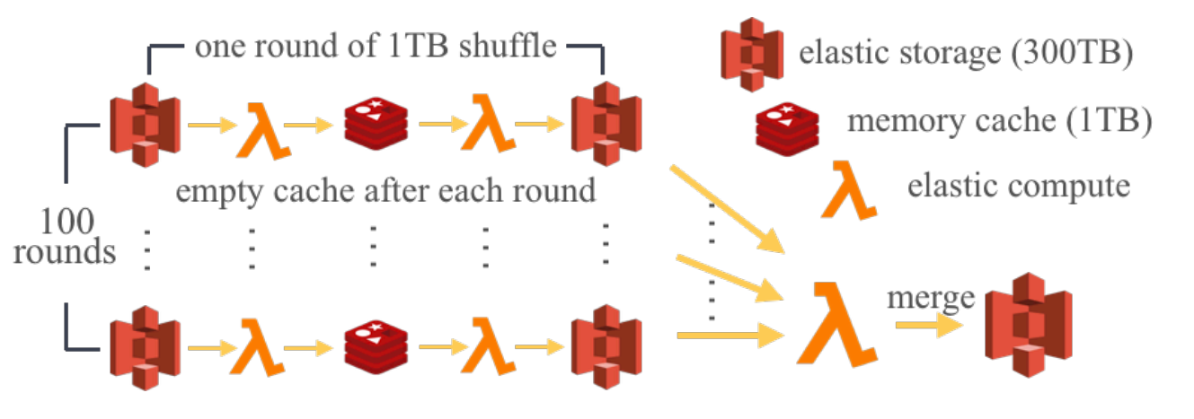
Locus^{[2]}
Locus^{[2]}
Hybrid shuffle
Job partition
eg：a 100 TB sort can be broken down to 100 rounds of 1TB sort
Multi-round shuffle
Within a round： fast storage for intermediate data
Job merge
Across rounds：slow storage to merge intermediate data
Illustration for hybrid shuffle
[2] Shuffling, Fast and Slow: Scalable Analytics on Serverless Infrastructure NSDI’19
Notes:
- 将快慢存储进行组合，首先将任务进行分组，每一组内的中间数据由快存储保存，最后将分组的数据合并，以此提高性能
- fast storage reuse，不是并行，那样需要快速存储的资源太多，成本太高，需要对快速存储进行重用

Slide 16
Locus^{[2]}
Locus^{[2]}
Hybrid shuffle
Slow storage
use S3 as the slow, elastic storage system
Fast storage
provision Redis nodes on Amazon ElastiCache
Illustration for hybrid shuffle
[2] Shuffling, Fast and Slow: Scalable Analytics on Serverless Infrastructure NSDI’19
Notes:
- 将快慢存储进行组合，首先将任务进行分组，每一组内的中间数据由快存储保存，最后将分组的数据合并，以此提高性能
- fast storage reuse，并不是所有轮并行，那样需要快速存储的资源太多，成本太高，需要对快速存储进行重用

Slide 17
FaaS
Conclusion
solution：involve running additional infrastructure on traditional VMs
challenges：such “serverful” component has the potential to severely
limit the atractiveness of FaaS
Notes:
- 所有解决方案都是在Faas这一端加入一些设备，来缓解FaaS本地存储资源有限的问题
- 这种方案可能会破环serverless的弹性

Slide 18
Reference
[1] Cloudburst: Stateful Functions-as-a-Service VLDB’20
[2] Shuffling, Fast and Slow: Scalable Analytics on Serverless Infrastructure NSDI’19
[3] Sonic: Application-aware Data Passing for Chained Serverless Applications ATC’21
[4] Boki: Stateful Serverless Computing with Shared Logs SOSP’21
[5] Anna: A kvs for any scale TKDE’19

Slide 19
下一步
四篇论文
Cloudburst: Stateful Functions-as-a-Service VLDB’20
Shuffling, Fast and Slow: Scalable Analytics on Serverless Infrastructure NSDI’19
Sonic: Application-aware Data Passing for Chained Serverless Applications ATC’21
Boki: Stateful Serverless Computing with Shared Logs SOSP’21

Slide 20
下一步
华为PPT
宏大叙事(混布场景)
动机：提高云上资源利用率
设计：
应用混合部署
保障QoS
用户黑盒应用
输入
预先建立的
应用特征知识库
原型系统
应用标签、资源预测、干扰模型等多维条件
保障QoS
精准的调度策略模型
输出

Slide 21
下一步
华为PPT
个人工作(单一场景)
Serverless data analytics
MapReduce sort
Query processing...
提取应用特征
I/O...
提出优化方案
分布式缓存、增加快速存储....
应用特征 知识库

Slide 22
OLAP
OLTP

